Slide 1
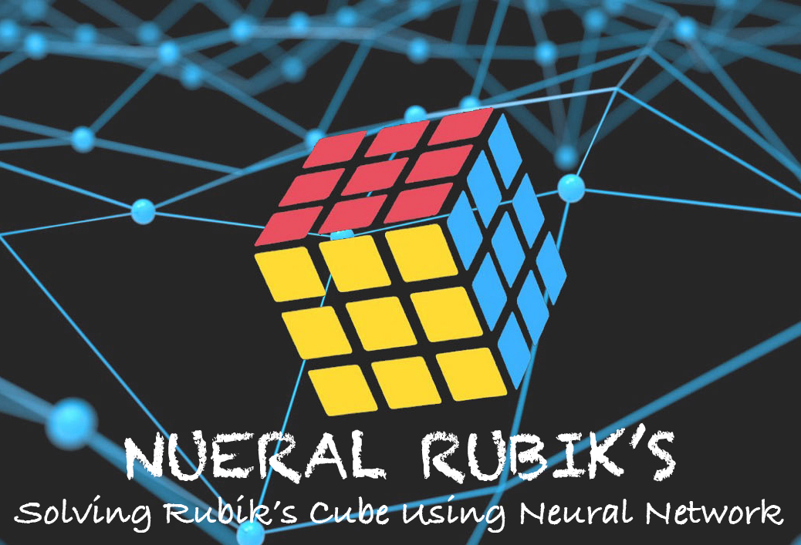
Candidate Name : Gunasegarran Magadevan
Matrix Number : WQD170002
Title : Neural Rubik’s – Solving Rubik’s Cube
Using Neural Network (Heuristic Learning)

Slide 2
CHAPTER 1 : INTRODUCTION
CHAPTER 2 : LITERATURE REVIEW
CHAPTER 3 : RESEARCH METHODOLOGY
REFERENCES
QUESTIONS & ANSWER

Slide 3
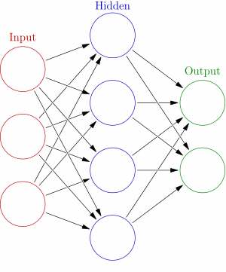
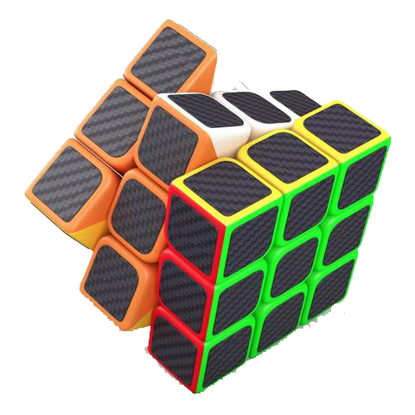
INTRODUCTION
Heuristic learning, involving or serving as an aid to learning, discovery, or problem-solving by experimental methods.
using trial-and-error which can speed up the process of finding a satisfactory solution.
”I have not failed 1000 times, but I have discovered 1000 ways how not to invent the light bulb” - Thomas Edison
The Rubik’s Cube is a 3D mechanical puzzle
The puzzle consists of 26 unique miniature cubes, also called “cubies”
Permutations:
The original (3×3×3) Rubik's Cube has 8 corners and 12 edges.
There are 8! ways to arrange the corner cubes.

Slide 4
INTRODUCTION
Problem
Statement
Implementing heuristic learning to solve a given instance Rubik’s cube problem.
Objective
To automatically solve a given instance Rubik’s cube problem using Heuristic Learning.
Research
Question
This research and experiment will show that the neural network, heuristic learning approach is competitive with state-of-the-art and might be the best choice in some use-case scenarios.
Research
Delivery
To prove this research and experiment of neural network using heuristic learning is the best choice in some use-case scenarios to solve Rubik’s Cube.
Research Significant
Minimal number of prediction of moves to solve a given instance Rubik’s cube.
Train a neural network to predict a minimal number of moves required to solve a given example of Rubik's cube. At that point utilize the trained system as a heuristic distance estimator with a standard forward-search algorithm and compare the results with other heuristics.
Train neural network to predict a min no. of moves required to solve a given case of Rubik’s cube.
Trained neural network as a heuristic distance estimator with a standard forward-search algorithm and compare the results with other heuristics.

Slide 5

LITERATURE REVIEW
Learnings | Pattern Database | Baseline | Boosting | Heuristic
Difference | A pattern is the partial specification of a permutation (or state); that is, the tiles occupying certain locations are unspecified. | A baseline prediction algorithm provides a set of predictions that you can evaluate as you would any predictions for the problem. | Boosting is a general method for enhancing the performance of a learning algorithm. It is a method for finding an exceptionally precise classifier on the preparation set, by joining "weak hypotheses”, every one of which needs just to be decently exact on the preparation set. | A heuristic is a general dependable guideline, normally created through understanding, that is joined into basic leadership process keeping in mind the end goal to tackle an issue. Numerous chart look calculations, for example, A∗, utilize heuristic-based pursuit.

Slide 6
RESEARCH
METHODOLOGY
This approach works as follows:
Run a breadth-first search (BFS) from the goal state, store every visited state together
with its goal- distance for as long as the memory suffices.
From the BFS frontier select K states at random.
From each of these K states, run a short random walk.
Among the states visited by random walks, select the desired number of states as a
training set.
GETTING DATA
QUANTITATIVE REASEARCH
Random Walks
A random walk is the process by which randomly-moving objects wander away from where they started.
Uses statistics for greater precision and objectivity

Slide 7
REFERENCE
D. Silver, A. Huang, et al. Mastering the game of Go with deep neural networks and tree search. Nature, 529(7587):484–489, 2016.
E. D. Demaine, S. Eisenstat, and M. Rudoy. Solving the Rubik’s Cube Optimally is NP-complete. ArXiv e-prints, June 2017.
Erez Karpas and Carmel Domshlak. Optimal search with inadmissible heuristics. In Proceedings of International Conference on Automated Planning and Scheduling, 2012.
Francisco Javier Ordóñez and Daniel Roggen. Deep Convolutional and LSTM Recurrent Neural Networks for Multimodal Wearable Activity Recognition, 2016.
Irwan Bello, HieuPham, QuocV.Le, MohammadNorouzi, and Samy Bengio. Neural Combinatorial Optimization
Jordan Thayer, Austin Dionne, and Wheeler Ruml. Learning inadmissible heuristics during search. In Proceedings of International Conference on Automated Planning and Scheduling, 2011.
Leedy, P. D. (1993). Practical research: planning and design. New Jersey: Prentice-Hall.
Matej Moravcˇík et al. DeepStack: Expert-level artificial intelligence in heads-up no-limit poker. Science, 356(6337):508–513, 2017.
Mehdi Samadi, Ariel Felner, and Jonathan Schaeffer. Learning from multiple heuristics, 2016.
Nathan R.Sturtevant, Ariel Felner, and MalteHelmert. Exploiting the rubik’s cube 12-edge PDB by combining partial pattern databases and bloom filters. In Stefan Edelkamp and Roman Barták, editors, Proceedings of the Seventh Annual Symposium on Combinatorial Search, SOCS 2014. AAAI Press, 2014.
Richard A. Monte. The Random Walk For Dummies, 2007.
Stuart J. Russell and Peter Norvig. Artificial Intelligence: A Modern Approach. Prentice Hall, 3 edition, 2010.
Sven Erick Alm. Simple random walk, 2006.
Thomas Keller, Florian Pommerening, Jendrik Seipp, Florian Geißer, and Robert Mattmüller. State-dependent cost partitioning’s for cartesian abstractions in classical planning. In Proceedings of the 25th International Joint Conference on Artificial Intelligence (IJCAI 2016), 2016.
with Reinforcement Learning. In Proceedings of the Fifth International Conference on Learning Representations, 2017.
Youssef Hamadi, Eric Monfroy, Springer-Verlag, and Frédéric Saubion. Autonomous search, 2012.

Slide 8

QUESTION
&
ANSWER

